Slide 1

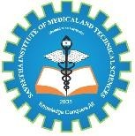
Cloud-Based Collaborative Document Editing and Version Control Platform
Presented by: Shri Shanmuga Priya K – 192324035
Ankala Lakshmi-192373066 CSA1522-Cloud Computing &Big Data Analytics
Guided by
Dr. P. Rajaram

Slide 2
Table of Content
S. No. | Contents
1 | Introduction
2 | Objectives
3 | Key Performance Parameters
4 | Literature Review / Background
5 | Methodology
6 | System Architecture
7 | Implementation
8 | Results & Discussion
9 | Challenges & Limitations
10 | Future Scope
11 | Conclusion
12 | References

Slide 3
Introduction
Introduction
Cloud-based collaboration enables multiple users to access and edit documents from different locations.
Traditional document sharing can create duplicate files, conflicting edits, and difficulty tracking changes.
Real-time collaborative editing allows users to work on the same document simultaneously.
The proposed system combines real-time editing with cloud-based version control.
Operational Transformation (OT) / CRDT techniques are used to handle concurrent edits and maintain consistency.
WebSocket communication provides fast, continuous synchronization between users.
A version-control module maintains complete document history, enabling users to review and retrieve previous versions.

Slide 4
Objectives
Objectives
Enable real-time collaboration between multiple users on the same document.
Minimize synchronization latency during collaborative editing.
Resolve concurrent editing conflicts accurately using OT/CRDT techniques.
Support multiple concurrent editors without significant performance degradation.
Maintain complete version history of document changes.
Provide fast version retrieval and restoration of previous document states.
Ensure secure and reliable cloud-based document storage and access.
Key Performance Parameters
Sync Latency
Conflict Resolution Accuracy
Concurrent Editor Capacity

Slide 5
Literature Review / Background
Study / Technology | Main Contribution | Relevance to Our Project
Fasola, O.S. and Abimbola, M.O., 2023 | Collaborative technology for information sharing, knowledge creation and management in libraries. | Provides the foundation for collaborative editing
Castelló, M., Kruse, O., Rapp, C. and Sharples, M., 2023 | Synchronous and asynchronous collaborative writing. | Helps understand ordering of concurrent operations
Operational Transformation (OT) | Transforms concurrent operations to maintain document consistency | Used for conflict resolution
CRDTs | Enables distributed data to merge while maintaining eventual convergence | Alternative approach for real-time collaboration
WebSocket (RFC 6455) | Provides persistent, two-way client-server communication | Enables real-time document synchronization
Version Control Systems | Maintain revisions and allow historical recovery | Supports document version history and restoration

Slide 6
Methodology
Requirement Analysis and System Design – Identify the requirements and design the cloud-based architecture, including frontend, backend, database, and real-time communication components.
User Authentication and Document Management – Implement secure user login, document creation, editing, sharing, and access-control functionalities.
Real-Time Collaborative Editing – Use Y.js and WebSocket technology to synchronize document changes between multiple users in real time and handle simultaneous edits.
Cloud Storage and Version Control – Persist document data in the cloud and maintain multiple document versions, allowing users to view, compare, and restore previous versions.
Testing, Performance Evaluation and Deployment – Test synchronization, security, reliability, and performance under multiple users, then deploy and evaluate the system in a cloud environment.

Slide 7
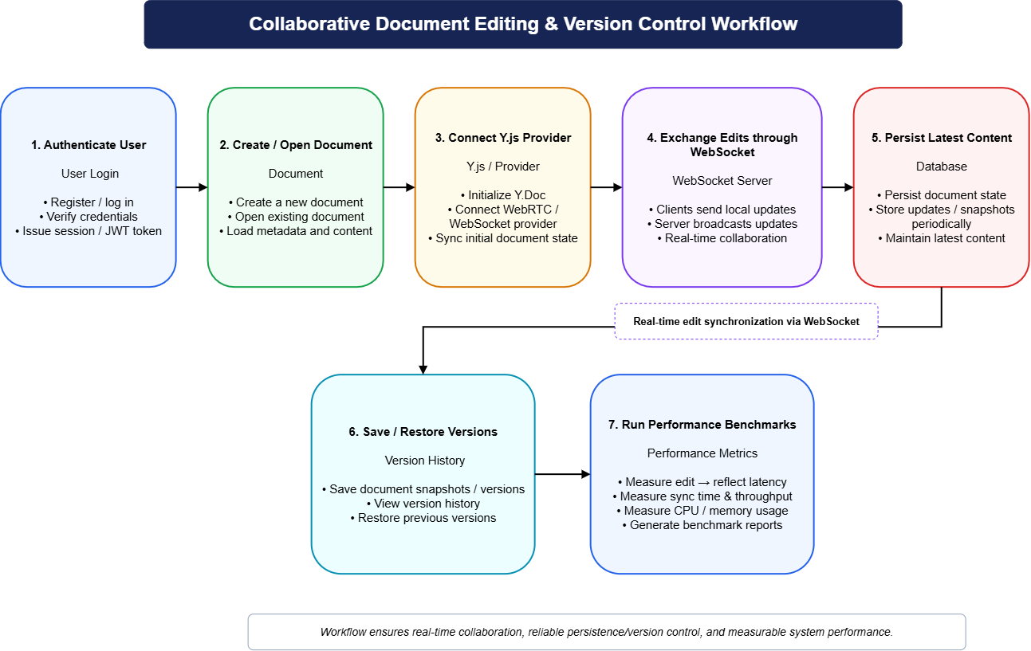
System Architecture
Fig: Workflow of Application

Slide 8
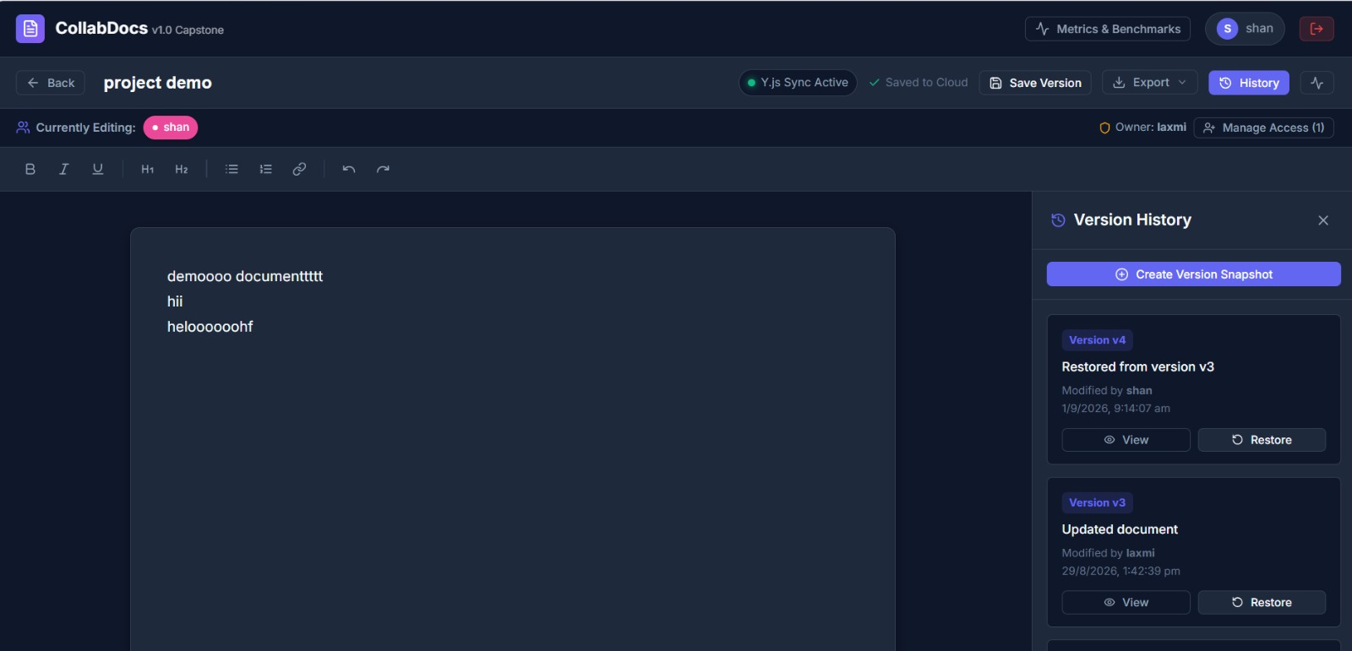
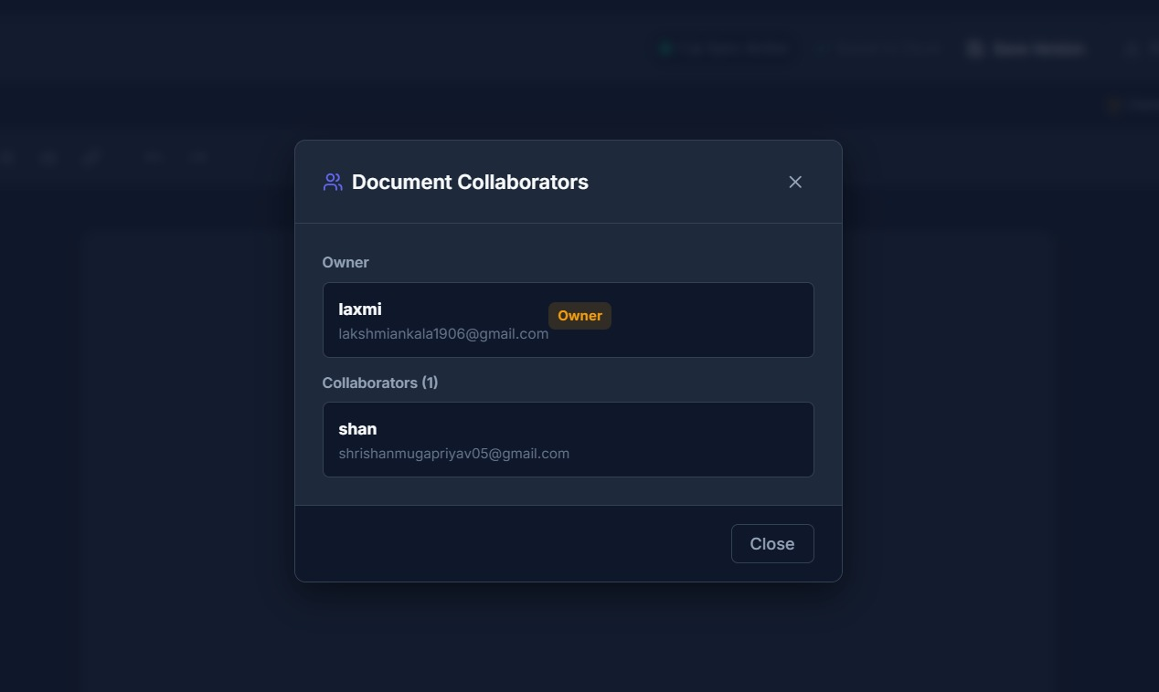
Module 1-Real-Time Collaborative Rich-Text Editing
Rich-Text Editing with Tiptap – Provides a powerful editor where users can create and format documents using headings, bold, italic, lists, links, tables, and other rich-text features.
Real-Time Synchronization with Y.js – Y.js uses CRDT technology to synchronize document changes automatically, allowing multiple users to edit the same document without overwriting each other’s work.
Fast Communication using WebSockets – WebSockets maintain a continuous connection between users and the server, enabling edits to be transmitted and reflected instantly across all connected users.
Collaborator Awareness – The system shows who is currently editing the document, including their cursor and presence, making teamwork more transparent and easier to coordinate.
Fig:2 Text Editing
Fig:3 Real Time Collaborative

Slide 9
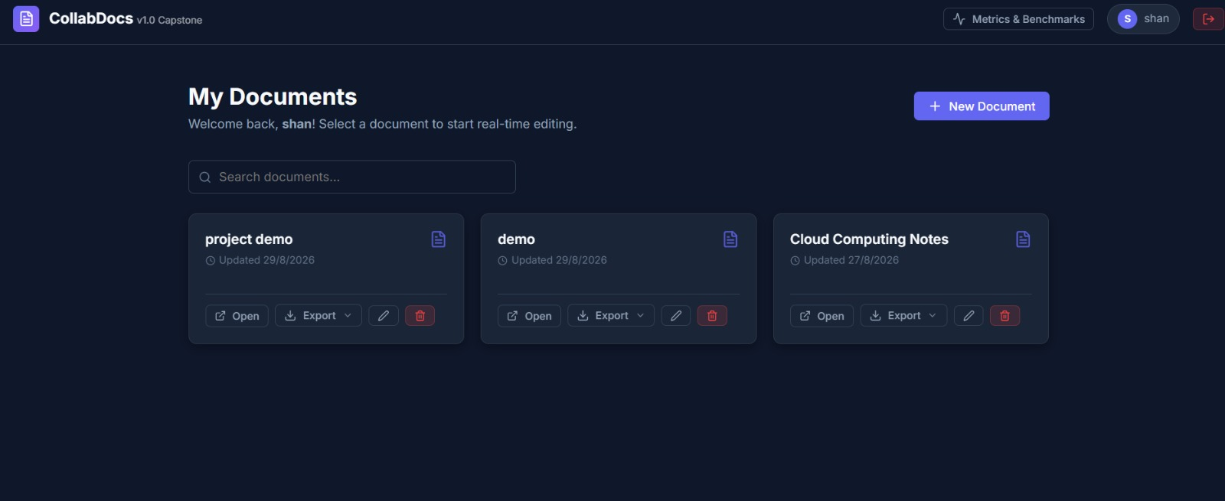
Module-2- Version Control and Document History
Version Snapshots – The system automatically saves snapshots of the document at important points, allowing every major change to be preserved separately.
History Timeline – A chronological timeline displays all saved versions with details such as version number, date, time, and author, making it easy to track document changes.
Version Preview – Users can preview any previous version without changing the current document, helping them review and compare earlier content safely.
Non-Destructive Restore using MongoDB – Previous versions are stored securely in MongoDB. When a user restores a version, it creates a new current version instead of deleting the existing history, ensuring complete version traceability.
Fig 4: History

Slide 10
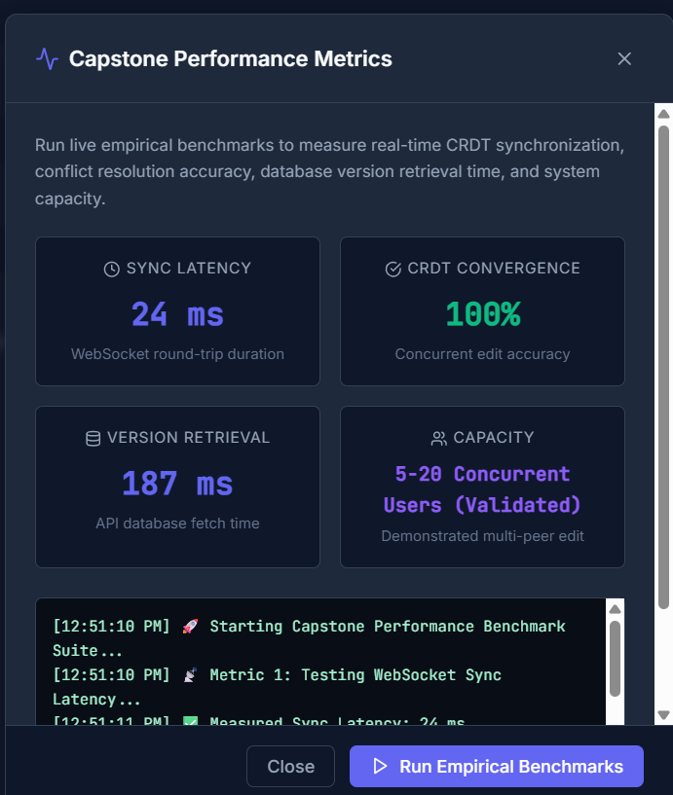
Results & Discussion
Observed benchmark run
Low WebSocket round-trip time supports responsive collaboration. 100% convergence indicates the controlled Y.js concurrent-edit test reached a consistent state. Version retrieval was measured through the real API/database path. The current validated capacity is 5–20 concurrent users; larger-scale deployment should be load-tested separately. Note: values are measurements from the demonstrated benchmark run, not fixed guarantees.
Fig 5:Performance and Metrics

Slide 11
Challenges & Limitations
Correct Y.js provider/awareness lifecycle: improper initialization can crash the editor. Reliable concurrent synchronization requires careful WebSocket and CRDT lifecycle management. Persistent content and immutable versions must remain separate from transient CRDT state. Document privacy requires backend authorization, not only frontend filtering. Current performance results are local/development measurements; production cloud scaling needs further load testing. MongoDB Atlas/cloud deployment and multi-instance WebSocket scaling require additional production configuration.

Slide 12
Future Scope
Deploy frontend, backend and MongoDB Atlas in a production cloud environment. Add invitation-based sharing, roles and fine-grained document permissions. Introduce Redis/pub-sub or a managed collaboration service for multi-server WebSocket scaling. Add offline-first editing and automatic reconnection with durable CRDT persistence. Add document comments, mentions, notifications and richer collaboration analytics. Add encryption-at-rest/key management, audit logs and stronger enterprise security controls.

Slide 13
Conclusion
The project demonstrates a cloud-ready collaborative document platform that combines: Real-time editing using Tiptap + Y.js CRDT WebSocket-based synchronization and collaborator awareness MongoDB persistence and immutable version history JWT authentication and protected backend services Non-destructive version restoration Empirical performance benchmarking Overall, the system provides a practical foundation for collaborative cloud applications while demonstrating the key concepts of synchronization, conflict resolution, persistence and scalability.

Slide 14
References
Fasola, O.S. and Abimbola, M.O., 2023. Collaborative technology for information sharing, knowledge creation and management in libraries. Gateway Information Journal, 24(1 & 2), pp.33-46.
Castelló, M., Kruse, O., Rapp, C. and Sharples, M., 2023. Synchronous and asynchronous collaborative writing. In Digital writing technologies in higher education: Theory, research, and practice (pp. 121-139). Cham: Springer International Publishing.
Rodriguez, B.A., Aquiatan, V.T., Verallo, C.J.A., Agpad, S.B., De Loyola, R.C. and Bibangco, E.J.P., 2024, June. Digitalization of document management and monitoring in the Department of the Interior and Local Government Negros Occidental. In 2024 15th International Conference on Computing Communication and Networking Technologies (ICCCNT) (pp. 1-8). IEEE.
Hammad, M., Iqbal, J., Hassan, C.A.U., Hussain, S., Ullah, S.S., Uddin, M., Malik, U.A., Abdelhaq, M. and Alsaqour, R., 2023. Blockchain-based decentralized architecture for software version control. Applied Sciences, 13(5), p.3066.
Chen, K.Y., Toro-Moreno, M. and Subramaniam, A.R., 2025. GitHub is an effective platform for collaborative and reproducible laboratory research. ArXiv, pp.arXiv-2408.
Scroggie, K.R., Burrell-Sander, K.J., Rutledge, P.J. and Motion, A., 2023. GitHub as an open electronic laboratory notebook for real-time sharing of knowledge and collaboration. Digital Discovery, 2(4), pp.1188-1196.

Slide 15
Thank You!

